Slide 1

Birthday Gift from Dad …
Notes:
That is laid-off

Slide 2


… Most Powerful Computer

Slide 3

Turing Machines
Chapter 17

Slide 4
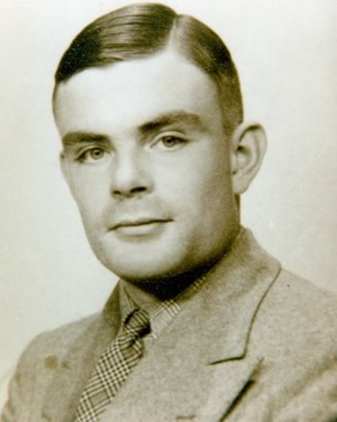
Alan Turing
One of the 100 Most Important People of the 20th Century
  For his role in the creation of the modern computer
  "The fact remains that everyone who taps at a keyboard, opening a spreadsheet or a word-processing program, is working on an incarnation of a Turing machine."
Turing machine, influential formalization of the concept of the algorithm and computation
Turing test, influential in AI
  1912 – 1954
1936 – 1938, PhD, Princeton, under Alonzo Church
Then, back to Cambridge, attended lectures by Ludwig Wittgenstein
about the foundations of mathematics.
  Ludwig Wittgenstein, student of Bertrand Russell at Cambridge, the two are widely referred to as the greatest philosophers of last century
Notes:
Human judge asking questions, to be answered by a human and a machine. If cannot tell the machine from the human, machine passes the test

Slide 5
Languages and Machines
SD
D
context-free
languages
regular
languages
reg exps
FSMs
cfgs
PDAs
unrestricted grammars
Turing Machines
recursively enumerable
recursive

Slide 6
Grammars, SD Languages, and Turing Machines
Generates
SD Language
Unrestricted Grammar
Recognizes
or
Accepts
Turing Machine

Slide 7
Turing Machines
  Can we come up with a new kind of automaton that has two properties:
  ● powerful enough to describe all computable things
  unlike FSMs and PDAs
  ● simple enough that we can reason formally about it
  like FSMs and PDAs
  unlike real computers

Slide 8
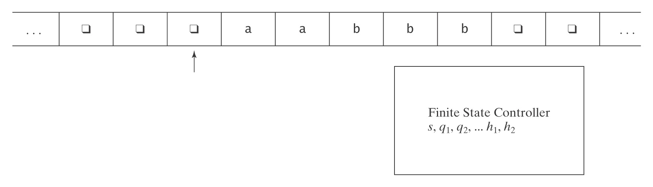
Turing Machines
  Replacing stack in PDA with a
  more flexible, writeable tape
  Single read/write head
  Input on the tape, no longer “consumed” as in FSM/PDA
  By convention, start state to the left of the leftmost symbol
  At each step, the machine must:
  ● choose its next state,
  ● write on the current square, and
  ● move left or right

Slide 9
A Formal Definition
A Turing machine M is a sixtuple (K, Σ, Γ, δ, s, A):
● K is a finite set of states;
● Σ is the input alphabet, which does not contain ;
● Γ is the tape alphabet, which must contain  and have Σ as a
subset.
● s ∈ K is the initial state;
● A ⊆ K is the set of accepting states;
● δ is the transition function:
K × Γ to K × Γ × {→, ←}
state × tape state × tape × action
char char (R or L)
This definition is a bit different from the book. It’s more consistent with DFSM, our definition of path, and the convention of “nowhere to go = ends without accepting”, which saves the effort in specifying transition tables and diagrams.
Notes:
This definition is similar to the one in Ullman book, P327, except that we do not have the B element in the definition.
Their definition is also cited in the wiki page for Turing machines.

Slide 10
A Formal Definition
K × Γ to K × Γ × {→, ←}
state × tape state × tape × action
char char (R or L)
If δ contains ((q₀, a), (q₁, b, R))
  when M is in state q₀, char under read/write head is a
  M will go to q₁, write b, and move to right))
is the tape symbol (blank symbol):
  the input string may not contain 
  initially, all tape squares except those that contain the input contain 
   helps in recognizing ends of input
  some definitions do not use it
a / b / R
q₀
q₁

Slide 11
Notes on the Definition
1. The input tape is infinite in both directions.
2. δ is a function, not a relation. So this is a definition for
deterministic Turing machines.
3. Turing machines do not necessarily halt (unlike DFSMs and DPDAs). Why? To halt, they must enter a halting state.
Otherwise they loop.
4. The above is the same to say, the path (since there’s only one) may or may not end.
5. Turing machines generate output so they can compute
functions.
Notes:
I use this convention, not sure if it’s perfectly accurate for TM or not.

Slide 12
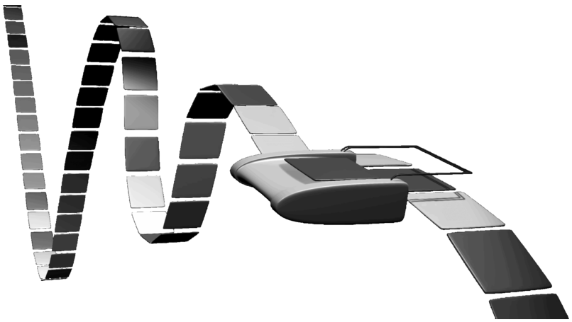
More on Turing Machines
Artistic
representation:
On sale
Simulator
Notes:
Toy company in Denmark

Slide 13
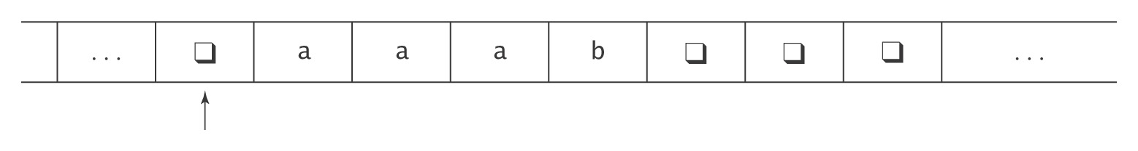
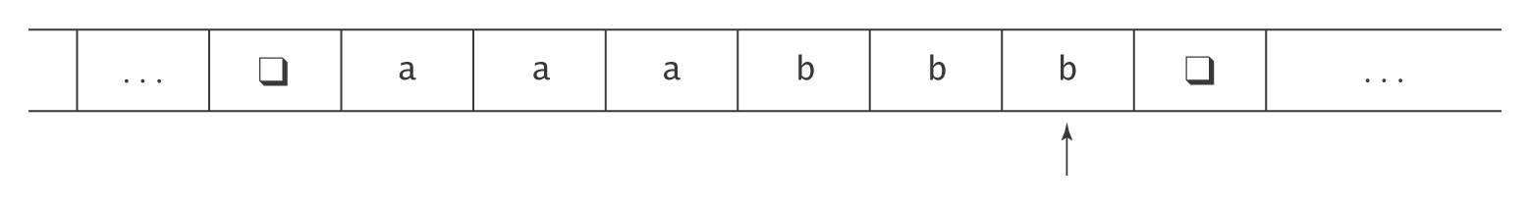
Add b’s to Make Them Match the a’s
M takes as input a string in the language:
{a^{i}b^{j}, 0 ≤ j ≤ i},
and adds b’s to make the number of b’s equal the number of a’s.
The input to M will look like this:
The output should be:

Slide 14
Describing M in English
1. Move one square to the right. If the character under the read/write head is black, halt. Otherwise, continue.
2. Loop:
2.1. Mark off an a with a $.
2.2. Scan rightward to the first b or black.
  If b, mark it off with a $ and get ready to go back and find the next matching a,b pair.
  If black, then there are no more b’s but there are still a’s that need matches. So it is necessary to write another b on the tape. But that b must be marked so that it cannot match another a. So write a #. Then get ready to go back and look for remaining unmarked a’s.
2.3. Scan back leftward looking for a or black. If a, then go back to the top of the loop and repeat. If black, then all a’s have been handled. Exit the loop. (Notice that the specification for M guarantees that there will not be more b’s than a’s).
3. Make one last pass all the way through the nonblank area of the tape, from left to right, changing each $ to an a and each # to a b.
4. Halt.
Notes:
P376 has the description

Slide 15
Defining M with Transition Table
K = {1, 2, 3, 4, 5, 6}, Σ = {a, b}, Γ = {a, b, , $, #},
s = 1, A = {6}, δ =
( ((1, ), (2, , ->)),
((1, a), (2, q, ->)),
… …
((2, ), (6, $, ->)),
((2, a), (3, $, ->)),
… …
((3, #), (4, $, <-)),
… …
((4, ), (5, , ->)),
… …
((5, ), (6, , <-)),
((5, $), (5, a, ->)),
((5, #), (5, b, ->)) )
The table can also look like this:
 | symbol
state | ❑ | a | b | $ | #
1 | (2, , ->)
2
3
4
5
Note: 6 is a halting state, no transition out of it
transition table is hard to read,
can use graphical representation.
Notes:
P367. some unusable elements of δ can be omited.

Slide 16
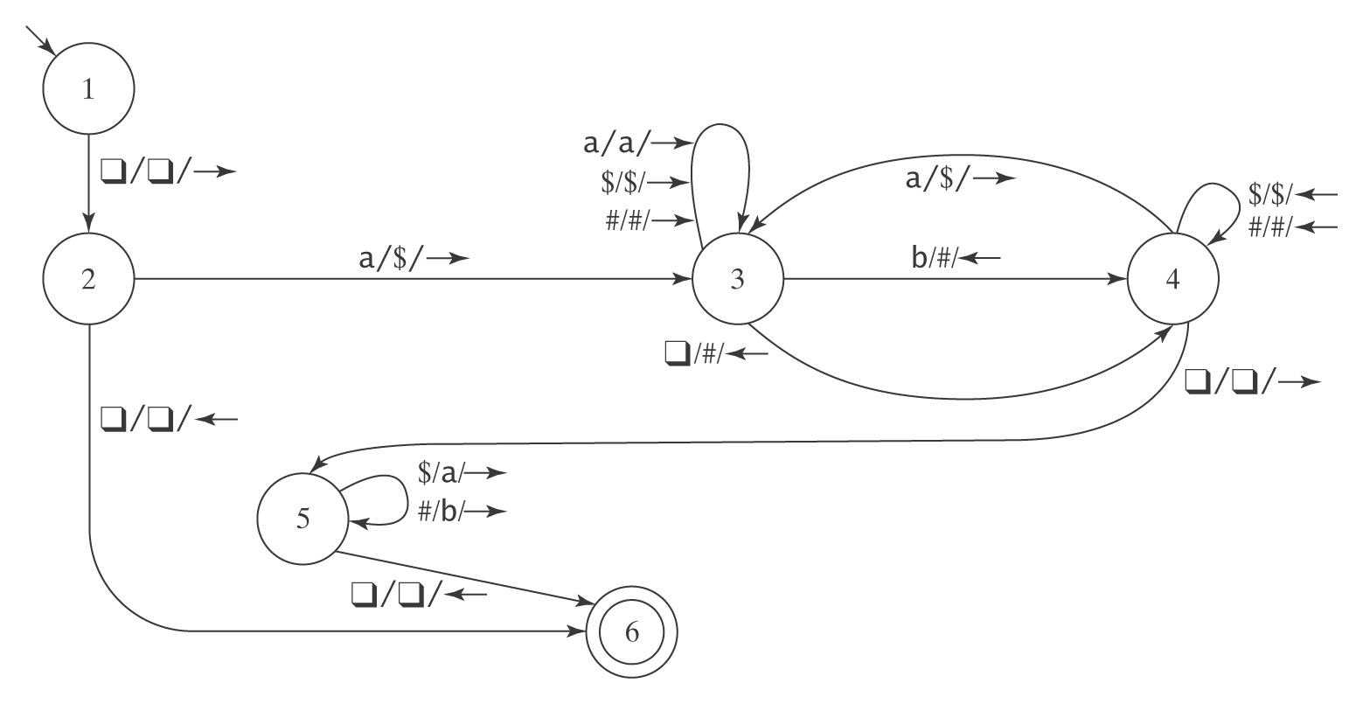
Defining M with Transition Diagram
K = {1, 2, 3, 4, 5, 6}, Σ = {a, b}, Γ = {a, b, , $, #},
s = 1, A = {6}, δ =
Notation may vary from book to book …
Notes:
transition table, hard to read, use graphical language
P366. M will operate as follows:
Move one square to the right …
Loop:
3. make one last pass, change back to a and b
4. halt

Slide 17
Notes on Programming
The machine has a strong procedural feel, with one phase coming after another.
There are common idioms, like scan left until you find a blank
There are two common ways to scan back and forth marking things off.
  Scan left to the first a and process the rest of a’s right to left, as in last example
  Scan all the way left until we find the first unmarked a, process all a’s left to right
If we care about output (function, not decision problem)
  often there is a final phase that makes one last pass over the tape and converts the marked characters back to proper form.
Even a very simple machine is a nuisance to write.

Slide 18
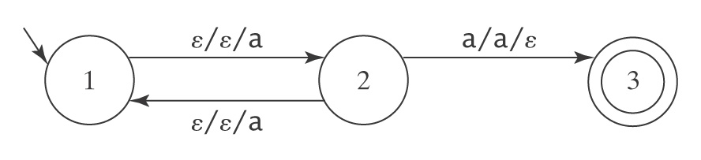
Halting
● A DFSM or DPDA M, on input w, is guaranteed to halt in at most |w| steps. i.e., the path ends.
● A NDFSM M, on input w, is not guaranteed to halt. But there is an equivalent DFSM M’ such that L(M) = L(M’).
● A NDPDA M, on input w, is not guaranteed to halt. But there is an equivalent NDPDA M’ such that L(M) = L(M’).
● A deterministic TM M, on input w, is not guaranteed to halt. i.e., the path may or may not end.
And, there exists no algorithm to construct an equivalent one that is guaranteed to do so.

Slide 19
Formalizing the Operation
A configuration of a Turing machine
M = (K, Σ, Γ, s, H) is an element of:
K × ((Γ- {}) Γ*) ∪ {ε} × Γ × (Γ* (Γ- {})) ∪ {ε}
state
Active tape to the left
of read/write head
Square under read/write head
Active tape to the right
of read/write head

Slide 20
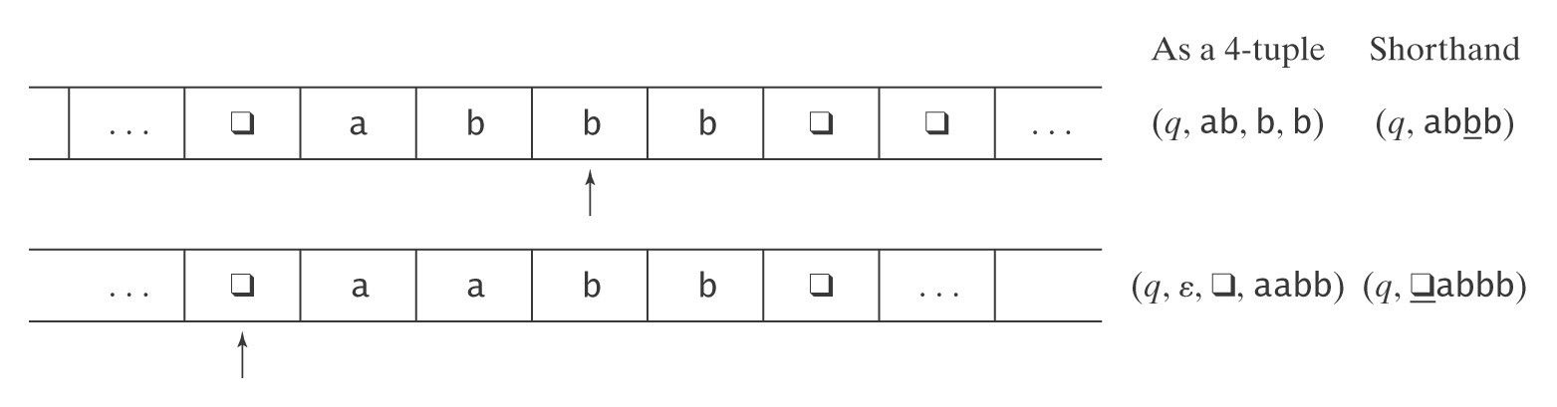
Example Configurations
(1) (q, ab, b, b) = (q, abbb)
(2) (q, ε, , aabb) = (q, aabb)
Initial configuration is (s, w).

Slide 21
Yields
(q₁, w₁) |-_{M} (q₂, w₂) iff (q₂, w₂) is derivable, via δ, in one step.
For any TM M, let |-_{M}* be the reflexive, transitive closure of |-_{M}.
Configuration C₁ yields configuration C₂ if: C₁ |-_{M}* C₂.
Recall: a path is a maximal sequence of steps from the start configuration.
Even for a deterministic TM, a path may end, or may not

Slide 22
Turing Machines as Language Recognizers
The initial configuration of M: (s, w)
Let M = (K, Σ, Γ, δ, s, {y}).
● M accepts a string w iff the path accepts it.
  For TM, (y, w′) is an accepting configuration
  We do not care the tape content when it halts
● M rejects a string w iff the path rejects it.
Possible that on input w, M neither accepts nor rejects. It may loop.
Again, this definition is a bit different from our text and Sipser, but similar to Ullman. This definition is more consistent to FSM and DPDA, i.e., all the non-accepting states are rejecting states.
This way, we do not need to draw the rejecting state and the many transitions to it.
It works just fine with JFLAP.
Notes:
TM can be used to:
1. recognize a language
2. Compute a function

Slide 23
Turing Machines as Language Recognizers
M decides a language L ⊆ Σ* iff:
For any string w ∈ Σ* it is true that:
if w ∈ L then M accepts w, and
if w ∉ L then M rejects w.
A language L is decidable iff there is a Turing machine M that decides it. In this case, we will say that L is in D.
In some books, D is called the set of recursive languages.
Computability theory was recursion theory, originated with work of Kurt Gödel, Alonzo Church, Alan Turing, Stephen Kleene …

Slide 24
A Deciding Example: A^{n}B^{n}C^{n}
A^{n}B^{n}C^{n} = {a^{n}b^{n}c^{n} : n ≥ 0}
Example : aabbcc
Example : aaccb
Not context-free, not recognizable by a PDA
Describing M in English:
1. Move right onto w. If the first character is black, halt and accept.
2. Loop:
2.1. Mark off an a with a 1.
2.2. Move right to the first b and mark it off with a 2. If there isn’t one, or if there is a c first, halt and reject.
2.3. Move right to the first c and mark it off with a 3. If there isn’t one, or if there is an a first, halt and reject.
2.4. Move all the way back to the left, then right again past all the 1s (the marked off a’s). If there is another a, go back to the top of the loop. If there isn’t, exit the loop.
3. All a’s have found matching b’s and c’s and the read/write head is just to the right of the region of marked off a’s. Continue moving left to the right to verify that all b’s and c’s have been marked. If they have, halt and accept. Otherwise halt and reject.
Notes:
P376 has the description

Slide 25
Another Deciding Example: wcw
WcW = {wcw : w ∈ {a, b}*}
Example: abbcabb 
Example: acabb
Describing M in English:
1. Loop:
1.1. Move right to the first character. If it is c, exit the loop. Otherwise, overwrite it with black and remember what it is.
1.2. Move right to the c. Then continue right to the first unmarked character. If it is black, halt and reject. (This will happen if the string to the right of c is shorter than the string to the left.) If it is anything else, check to see whether it matches the remembered character from the previous step. If it does not, halt and reject. If it does, mark it off with #.
1.3. Move back leftward to the first black.
3. There are no characters remaining before the c. Make one last sweep left to right checking that there are no unmarked characters after the c and before the first black. If there are, halt and reject. Otherwise, halt and accept.
Notes:
p377

Slide 26
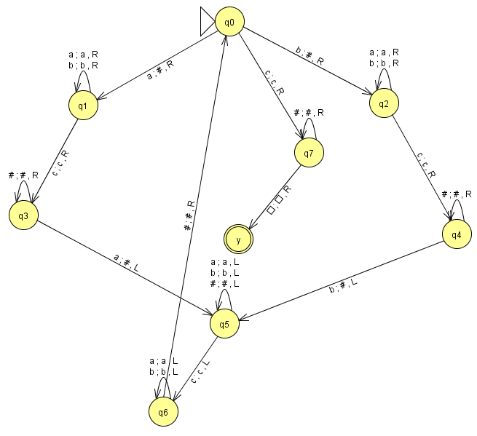
wcw: define M with transition diagram
K = {q₀, q₁, q₂, q₃, q₄, q₅, q₆, q₇, y},
= {a, b, c},
Γ = {a, b, c, # , },
s = q₀ ,
A = {y},
δ =
Exercise:
define M with transition table
wcw.jff
Notes:
Sipser p145, p139

Slide 27
Semideciding a Language
Let Σ be the input alphabet to a TM M. Let L ⊆ Σ*.
M semidecides L iff, for any string w ∈ Σ_{M}*:
● w ∈ L → M accepts w
● w ∉ L → M does not accept w. M may either:
reject or
fail to halt.
A language L is semidecidable iff there is a Turing machine that semidecides it. We define the set SD to be the set of all semidecidable languages.
In some books, SD is called the set of recursively enumerable languages.

Slide 28
Example of Semideciding
Let L = b*a(a ∪ b)*
We can build M to semidecide L:
1. Loop
  1.1 Move one square to the right. If the character under
  the read head is an a, halt and accept.
Can we build M to decide L?

Slide 29
Example of Semideciding
L = b*a(a ∪ b)*. We can also decide L:
  Loop:
    1.1 Move one square to the right.
    1.2 If the character under the read/write head is
    an a, halt and accept.
    1.3 If it is , halt and reject.
However, as we will prove later, there are L that is in SD but not D.

Slide 30
Computing Functions
When a Turing machine halts, there is a value on its tape.
So, it can be used to compute functions.
Deciding (semideciding) a language L is computing the characteristic function (partial characteristic function) of L
  Part of Chapter 25, use ch25.ppt
Notes:
Note, this is a bit different from the text (p379)
Different resources have different definitions. E.g. Wiki, define computable to be partial recursive (instead of recursive)
Also note the definition of “domain”, most recursion theorists, take “domain” as the defined members …
I define it this way because I feel this is consistent with everything …
e.g., when we say a language is decidable (computable), the characteristic function needs to be total (in set, 1, not in set, 0).
The definition “computable” in the text allows M to halt on some undefined input, so a computable function needs not to be total. but my understanding is that there cannot be undefined input, need to be total. Because for sets, computable = decidable …
Also look at p561, seems to confirm my definition.

Slide 31
Why Are We Working with Our Hands Tied Behind Our Backs?
Turing machines Are more powerful than any of
the other formalisms we have
studied so far. ☺
Turing machines Are a lot harder to work with than
all the real computers we have
available.
☹
Why bother?
The very simplicity that makes it hard to program Turing machines makes it possible to reason formally about what they can do. If we can, once, show that anything a real computer can do can be done (albeit clumsily) on a Turing machine, then we have a way to reason about what real computers can do.

Slide 32
Turing Machines
Sections 17.3 – 17.5

Slide 33
Turing Machine Extensions
There are many extensions we might like to make to our basic Turing machine model. But:
We can show that every extended machine
has an equivalent basic machine.
Some possible extensions:
● Multiple tape TMs
● Nondeterministic TMs

Slide 34
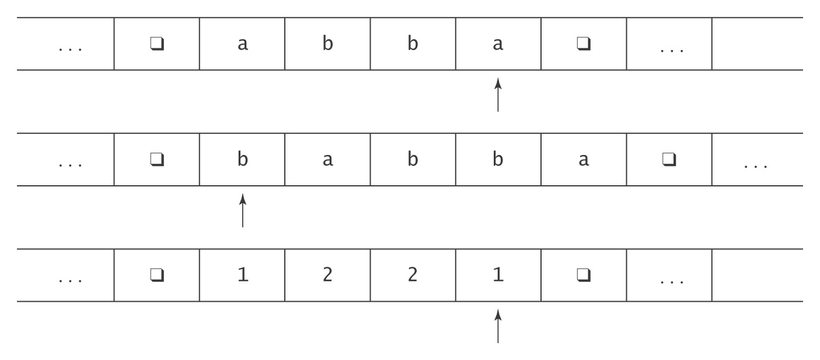
Multiple Tapes
Adding Tapes Adds No Power

Slide 35
Impact of Nondeterminism
● FSMs
  ● Computability NO
  ● Complexity
    Time NO
    Space YES
● PDAs
  ● Computability YES
● Turing machines
  ● Computability NO
  ● Complexity ?
?: allows “lucky guesses”. In this sense, it adds “superpower”.
It may take exponentially more steps to solve a problem using a deterministic TM.

Slide 36
Nondeterministic Turing Machines
A nondeterministic TM is a sixtuple (K, Σ, Γ, Δ, s, A).
Δ is a subset of:
(K × Γ) × (K × Γ × {←, →})
Similarly,
M accepts w iff there exists some path that accepts it.
M rejects w iff all paths reject it.
It is possible that, on input w∉L(M), M neither accepts nor rejects. In that case, no path accepts and some path does not reject.

Slide 37
Nondeterministic Function Computation
M computes a function f iff, ∀w ∈ Σ* :
● All of M’s paths end and result in f(w).

Slide 38
Equivalence of Deterministic and Nondeterministic Turing Machines
Theorem: If a nondeterministic TM M decides or semidecides a language, or computes a function, then there is a standard TM M' semideciding or deciding the same language or computing the same function.
Proof: (by construction). We must do separate constructions for deciding/semideciding and for function computation.

Slide 39
Simulating a Real Computer
Theorem: A random-access, stored program computer can be simulated by a Turing Machine. If the computer requires n steps to perform some operation, the Turing Machine simulation will require O(n⁶) steps.
On the other hand, there are also lots of simulation of TMs by real computers, check it out on the web.

Slide 40
Turing Machines
Sections 17.6 – 17.7

Slide 41
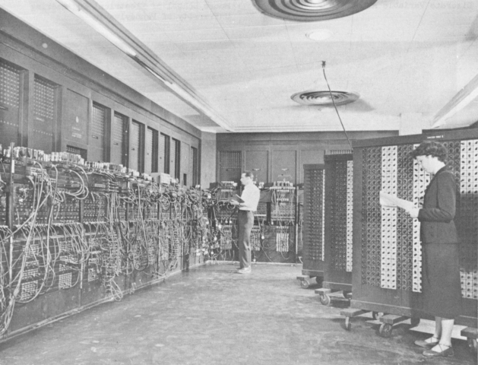
The Universal Turing Machine
All our machines so far are hardwired.
ENIAC - 1945
Notes:
ENIAC, short for Electronic Numerical Integrator And Computer, was the first general-purpose electronic computer. It was a Turing-complete. Its first use was in calculations for the hydrogen bomb.
The ENIAC's design and construction were financed by the United States Army during World War II. Build 1943 - 1946 at the University of Pennsylvania, having cost almost $500,000.

Slide 42
The Universal Turing Machine
All our machines so far are hardwired.
Question: Can we build a programmable TM that accepts
as input a (M: Turing machine, w: input string) pair
and outputs whatever M would output when started up on w?
Answer: Yes, it’s called the Universal Turing Machine.
To define the Universal Turing Machine U we need to:
Define an encoding scheme that can be used to describe to U a (M, w) pair
  <M, w>, many ways of encoding …
Describe the operation of U given input <M, w>

Slide 43
The Specification of the U
On input <M, w>, U must:
● Halt iff M halts on w.
● If M is a deciding or semideciding machine, then:
  ● If M accepts, accept.
  ● If M rejects, reject.
● If M computes a function, then U(<M, w>) must equal M(w).

Slide 44
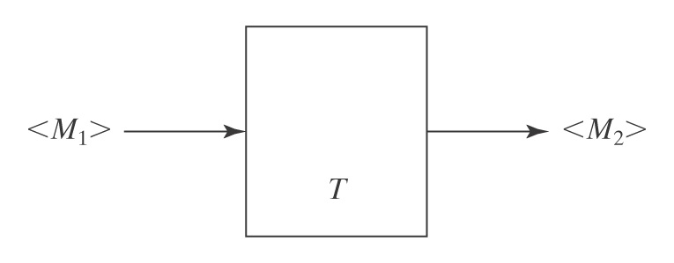
Another Benefit of Encoding
Another benefit of defining a way to encode any Turing machine M:
● We can talk about operations on TMs, as they are just input strings.
In the following, T (a Turing machine) takes one TM as input and creates another as its output.
This idea of transforming one TM to another has extensive use in reduction, to show that various problems are undecidable.

Slide 45
How U Works
U will use 3 tapes:
● Tape 1: M’s tape.
● Tape 2: <M>, the “program” that U is running.
● Tape 3: M’s state.

Slide 46
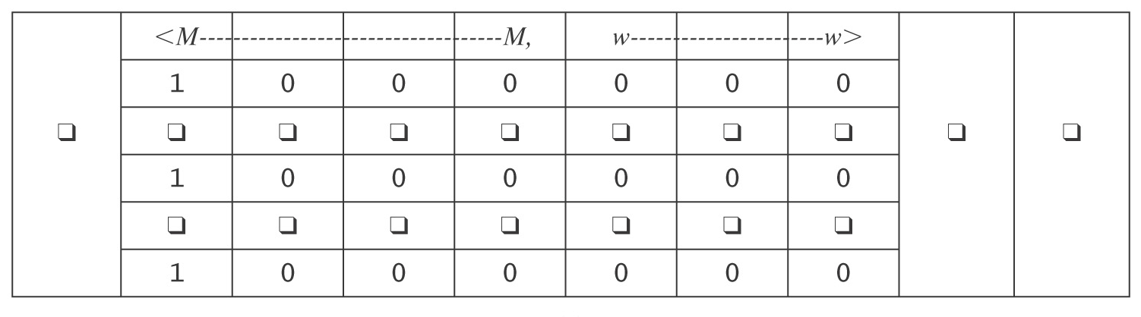
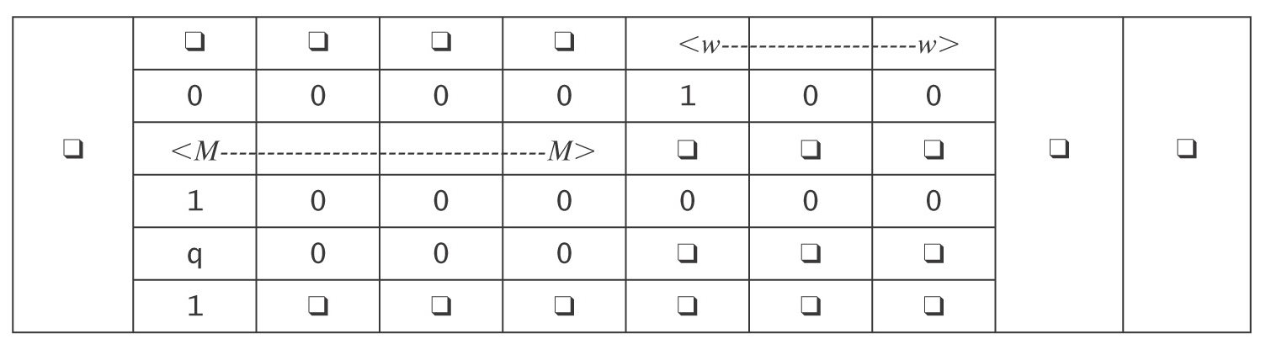
The Universal TM
Initialization of U:
1. Copy <M> onto tape 2.
2. Look at <M>, figure out what i is, and write the encoding of state
s on tape 3.
After initialization:

Slide 47
The Operation of U
Simulate the steps of M :
1. Until M would halt do:
  1.1 Scan tape 2 for a quintuple that matches the current state,
  input pair.
  1.2 Perform the associated action, by changing tapes 1 and 3. If
  necessary, extend the tape.
  1.3 If no matching quintuple found, halt. Else loop.
2. Report the same result M would report.
How long does U take?

